Slide 1
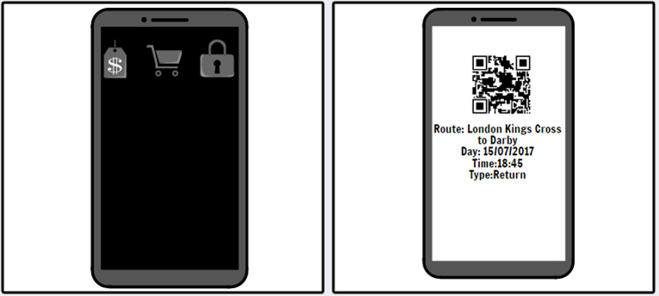
Notes:
This is will be replace the current system this potentially work with the system instead some sort of smart card you can use phone. The first the payment could be made from a mobile bank transfer, PayPal and maybe even apple or android app. Then it will store the ticket on the app which means that your ticket is stored on your phone if it can use barcode/ NFC to scan through to get through gates this system can work off with the one off ticket system if we put RFID tags in the current tickets. It could even store the tickets and journeys of the on the actual mobile phone app which mean that the person has there data on the app it could store all their personal data including a picture of them for recognition.

Slide 2
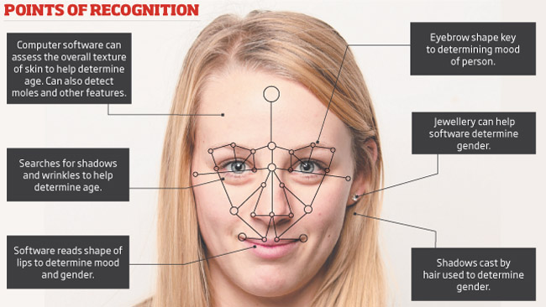
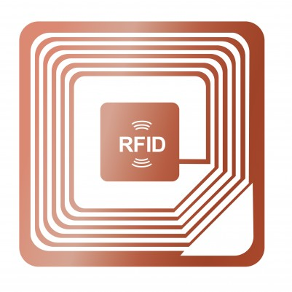
Notes:
This is simple instead of using the conventional ticketing service you basically use a facial scanner to add a data base and this logs to a train time and location this is only for a one off, however if it for a week then your face will be on the database for a week. However if you have traveled before the system will store your face for 2 years according to the Data Protection act 1995 unless you asked for it to be deleted immediately. The system logs you in as you walk onto a train platform. If you are not part of the logged members on that platform you will be red flagged and the authorities will be reported through the system and handed a picture of you. If you want to buy a ticket you have to upload a picture which is no more than 1 year old. Then there is also ticket machine that scan your faces in at the station. The conductor also has facial scanner which can be utilised.

Slide 3
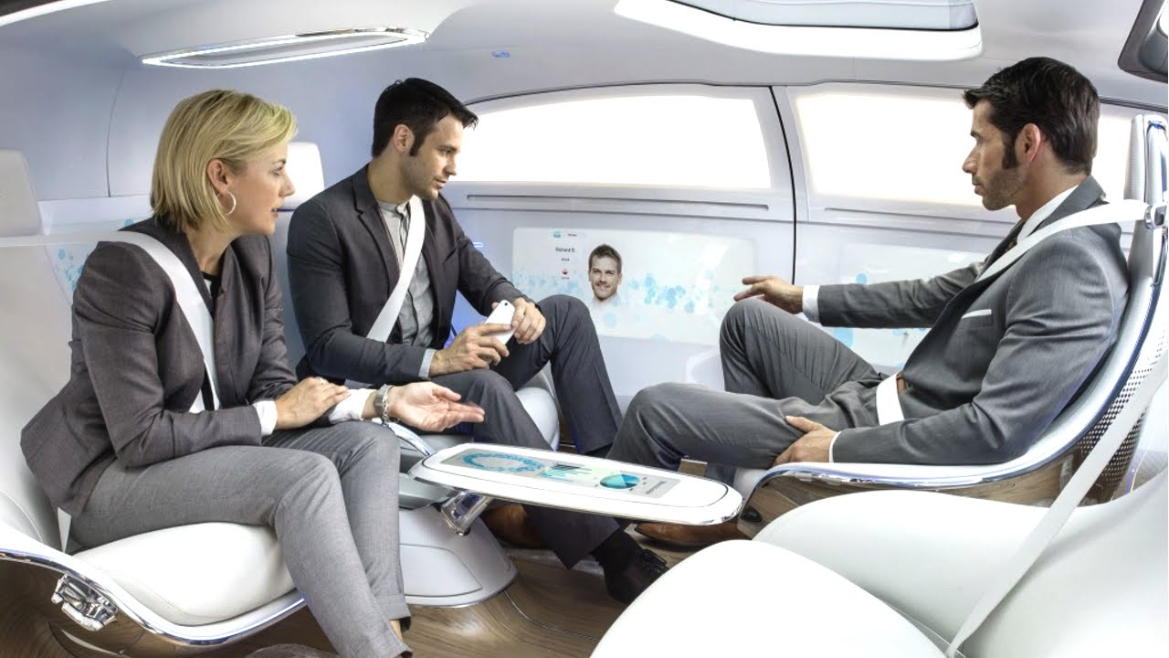
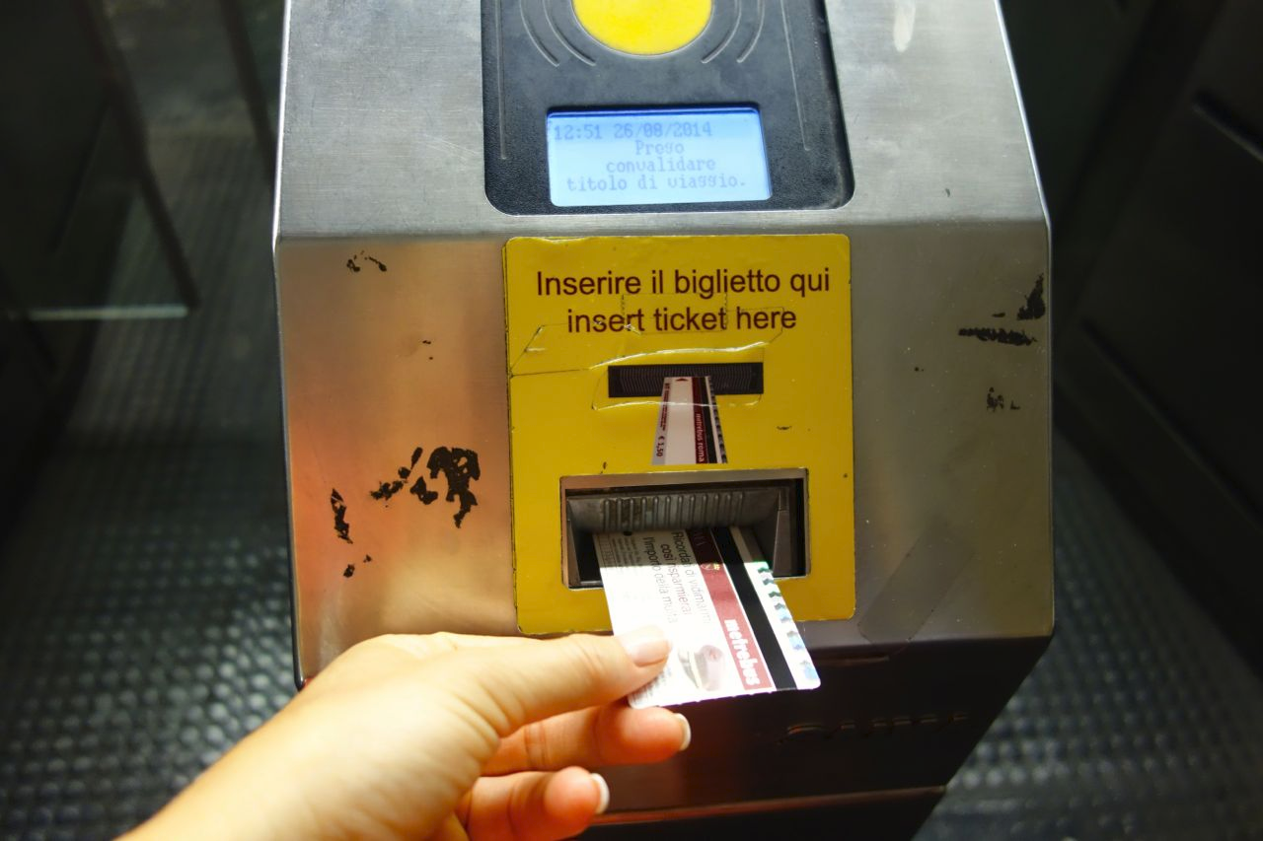
Notes:
This is integrates a new method of transport onto the ticketing system which will work by you putting your ticket or smart card for that matter into the car then the car would then from your ticket then it will open the door. It will also use the door locate where you are going and then once your seat belt is on the car will set off. The system works a bit different if you have smartcard basically you would insert your card and then it will ask you for a destination by voice recognition and then if you have the sufficient funds it will allow you travel.

